Slide 1
Understanding verbs
GET
PUT
POST
DELETE
PATCH
Remember consistency!
@schneidenbach

Slide 2
POST
@schneidenbach

Slide 3
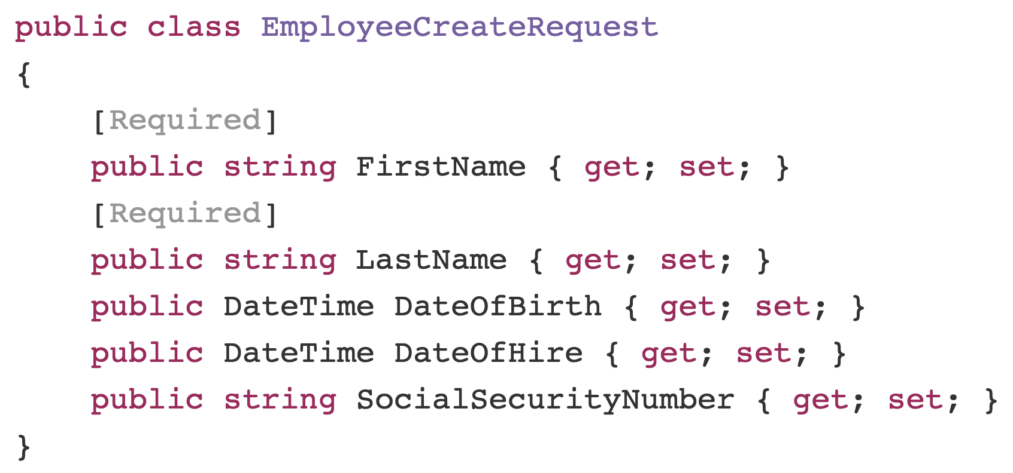

Slide 4
PUT
@schneidenbach

Slide 5
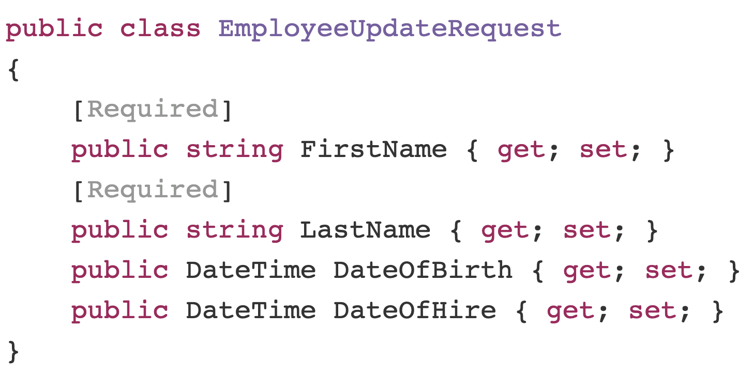
@schneidenbach

Slide 6
DELETE
@schneidenbach

Slide 7
PATCH
https://medium.com/backticks-tildes/restful-api-design-put-vs-patch-4a061aa3ed0b
@schneidenbach

Slide 8
Good HTTP Codes
200 OK
201 Created
400 Bad Request
404 Not Found
401 Unauthorized
(aka not authenticated)
403 Forbidden
(aka you can’t do that)
@schneidenbach

Slide 9
Error reporting
Errors are going to happen.
How will you manage them?
@schneidenbach

Slide 10
Error reporting
POST /vendors
POST /employees
Requires name and state
Requires first and last name
{
"name": "Aviron Software"
}
{
"firstName": "Spencer"
}
400 Bad Request
Content-Type: application/json
"State is required."
400 Bad Request
Content-Type: application/json
{
"errorMessage": "Your request was invalid."
}
@schneidenbach

Slide 11
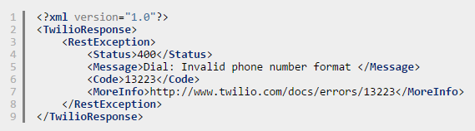
Error reporting
@schneidenbach

Slide 12

Error reporting
Make finding and fixing errors as easy on your consumer as possible.
@schneidenbach

Slide 13
Error reporting
Make finding and fixing errors as easy on your consumer as possible.
(Luckily we have [ApiController])
@schneidenbach

Slide 14
Validation
Validate. Validate. Validate.
@schneidenbach

